Slide 1


MSDS 6306: Doing Data Science - Case Study 02 Employee Attrition Analysis
By
-Sowmya Mani

Slide 2






Slide 3



Introduction
DDSAnalytics is an analytics company that specializes in talent management solutions for Fortune 100 companies
Talent management is defined as the iterative process of developing and retaining employees. It may include workforce planning, employee training programs, identifying high-potential employees and reducing/preventing voluntary employee turnover (attrition)
To gain a competitive edge over its competition, DDSAnalytics is planning to leverage data science for talent management
The executive leadership has identified predicting employee turnover as its first application of data science for talent management
The goal of the project is to conduct an analysis of existing employee and predict the Employee Income and the Attrition Rate

Slide 4
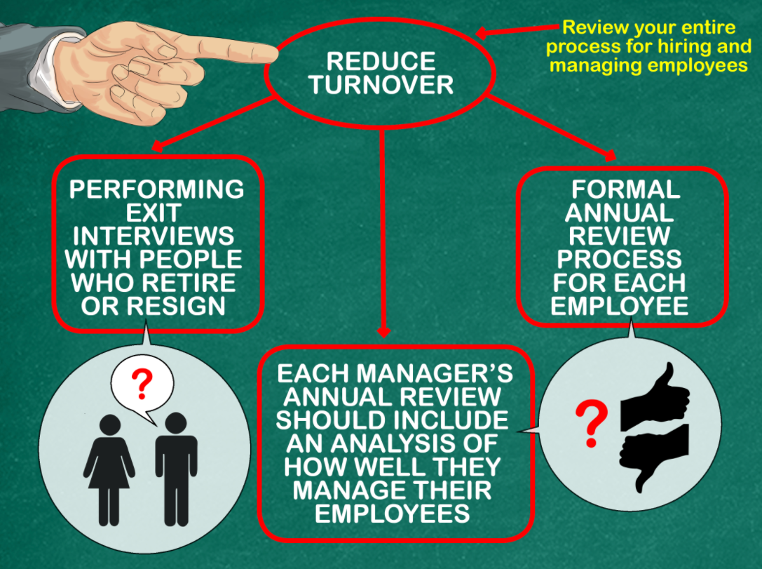
Goal of the Case Study
This Case Study is about analyzing the workforce planning, employee training programs, identifying high-potential employees and reducing/preventing voluntary employee turnover (attrition) for FritoLAy
The goal is too:
Identify the top three factors that contribute to turnover
Learning about any job role specific trends that may exist
Identify interesting trends and observations from the analysis
Predict Attrition
Predict Monthly Income

Slide 5
EDA
Exploratory Data Analysis

Slide 6
Dataset Analysis Original variable descriptions
Age: Age of the Employee
Attrition: Attrition Status of the Employee
Business Travel: Travel required in the job
DailyRate: Daily Rate of the Employee
Department: Department in the company where the Employee is working for
DistanceFromHome: Distance the employee travels from home to work
Education: Education level of Employee
EducationField: Employee Field of study
EmployeeCount: Count of Employee per observation
EmployeeNumber: Employee ID a unique identifier of Employee
EnvironmentSatisfaction: Employee Satisfaction number
Gender: Gender of Employee
HourlyRate: Hourly Rate of Employee
JobInvolvement: Job involvement of Employee
JobLevel: Job Level of Employee
JobRole: Designation of the Employee
JobSatisfaction: Job satisfaction of Employee
MaritalStatus: Marital status of Employee
MonthlyIncome: Monthly income of Employee
MonthlyRate: Monthly rate of employee
NumCompaniesWorked: Number of companies worked by employee
Over18:Check if Employee > 18
OverTime:Is the employee working overtime
PercentSalaryHike:Percentage of Salary Hike
PerformanceRating: Performance Rating
RelationshipSatisfaction: Employee relationship satisfaction
StandardHours:Standard work hours of employee
StockOptionLevel: Stock option level
TotalWorkingYears: Total work years of experience
TrainingTimesLastYear: Hours of training last year
WorkLifeBalance: Work life balance
YearsAtCompany: Number of years worked in this company
YearsInCurrentRole: Years of Employee in current role
YearsSinceLastPromotion: Years of employee since last promotion
YearsWithCurrManager: Years of employee with same manager

Slide 7
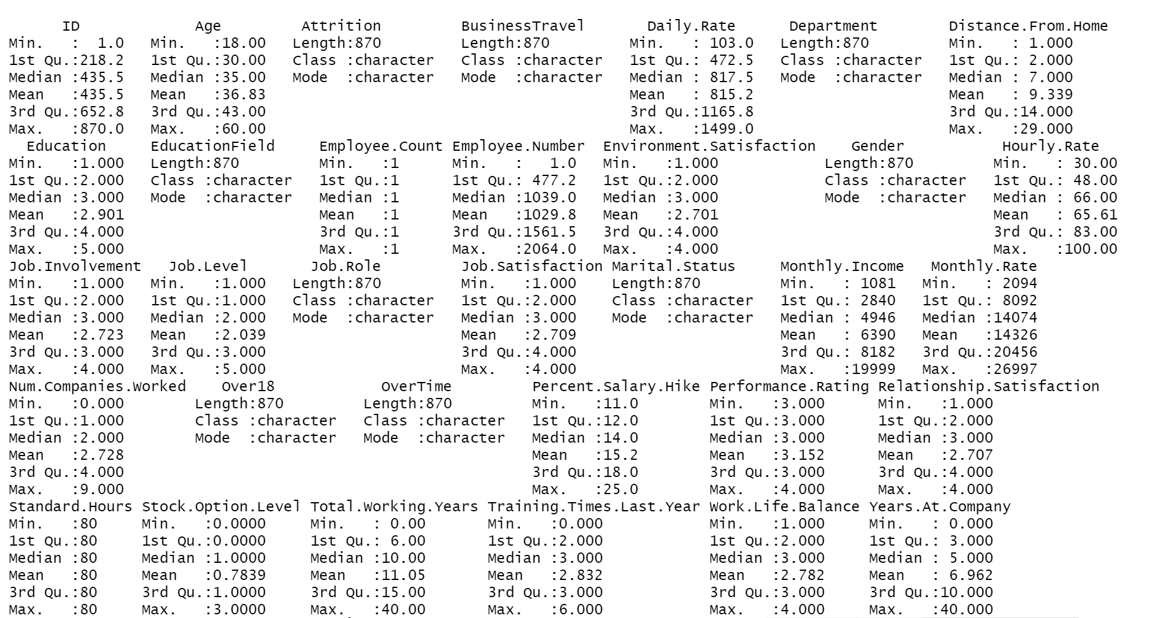
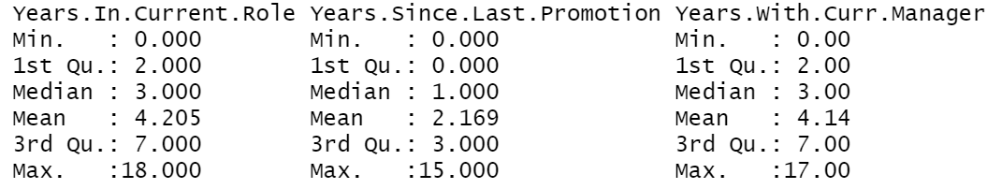
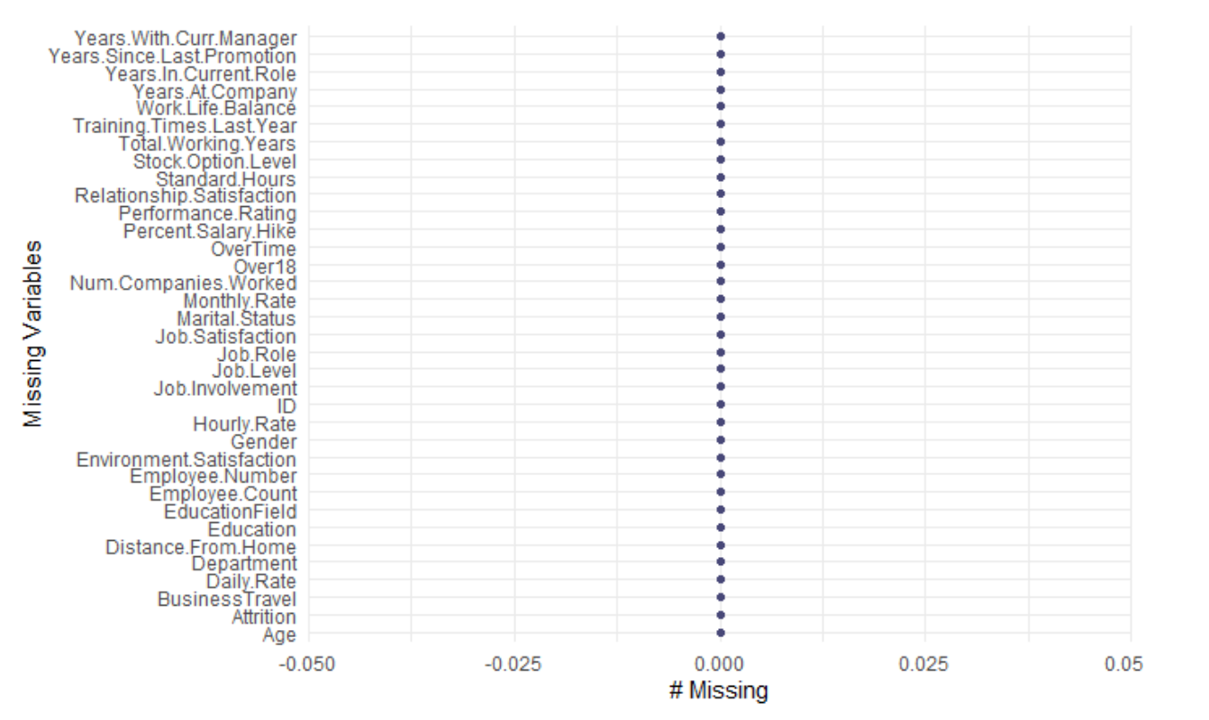
Initial Data Analysis
Employee Attrition Dataset has 36 variables describing 870 employees
It is obtained from existing Employee data from Frito-Lay
Data is collected from various departments and employees with
Various educational background
Age ranging from 18-60 years
Monthly income ranging from $1081-$19,999
Various Job level & Job Role
Work Experience
Promotion Status..etc

Slide 8
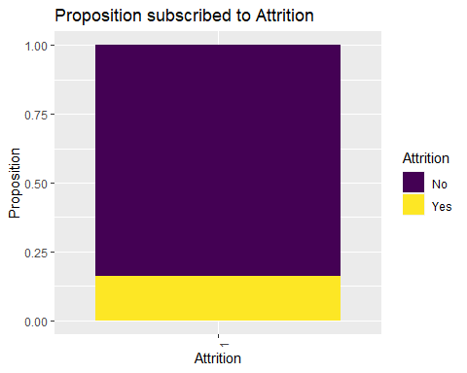
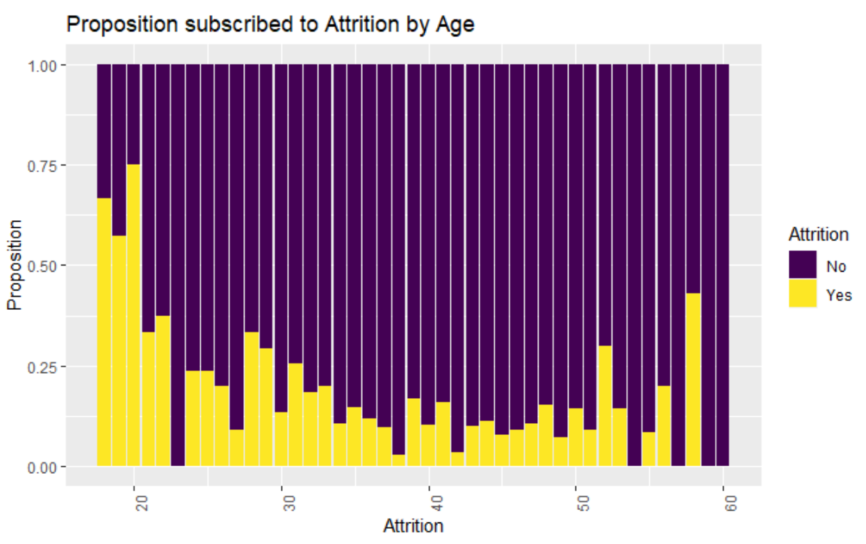
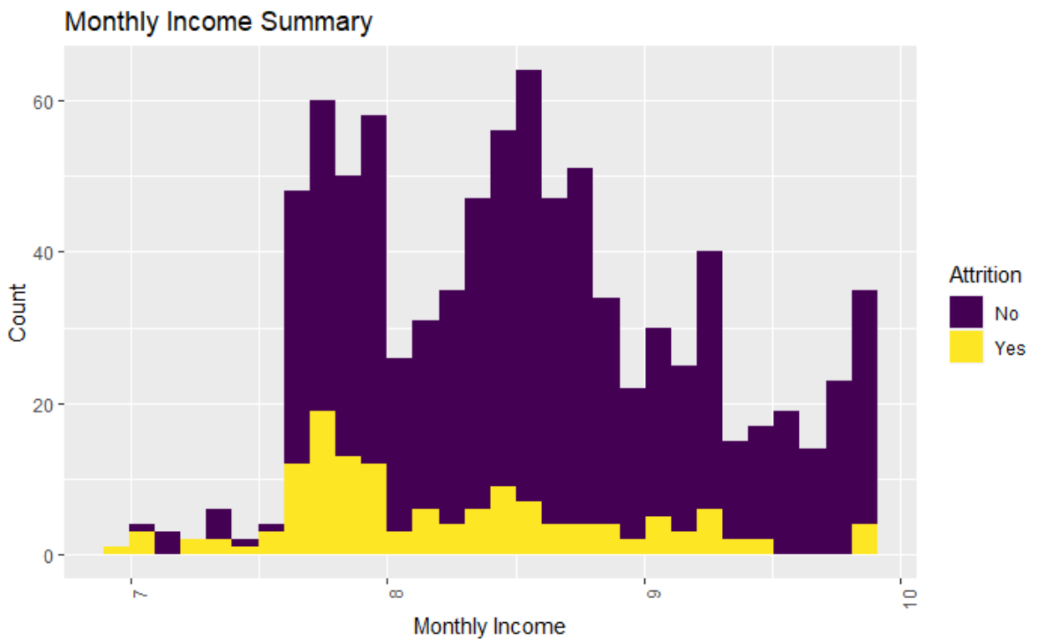
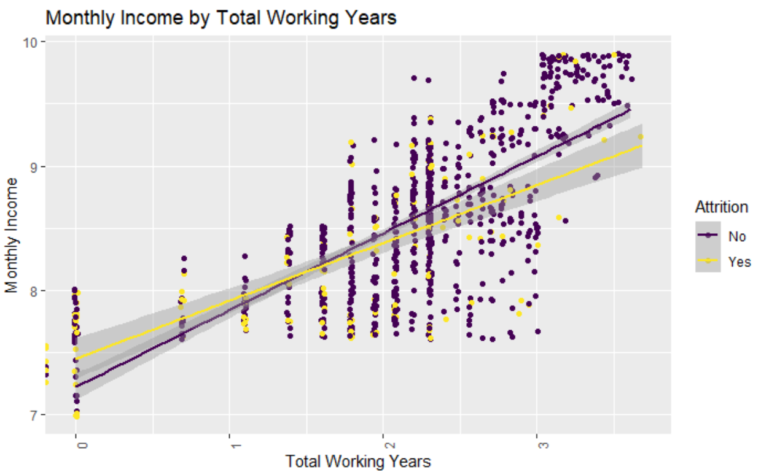
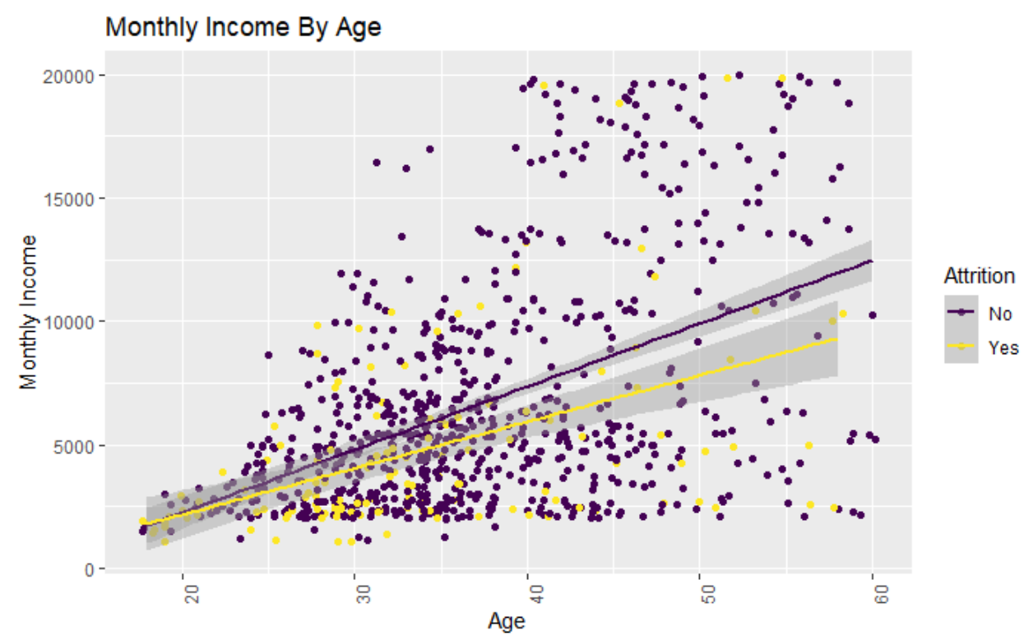
Initial Data Analysis
Overall attrition rate is 16%
Attrition is higher for Employees Aged < 35 and Age >50
Monthly income is not normal, and a log transformation was required to fix normality
Higher attrition observed within a certain range of Monthly income
Monthly Income is correlated to Total Working years of Employee
Age is correlated to Monthly Income
There is an outlier at ID 485 where the Employee total working years is 40 and in the same company which is a rare scenario, and which was removed from the dataset
Let us investigate the factors that cause attrition

Slide 9
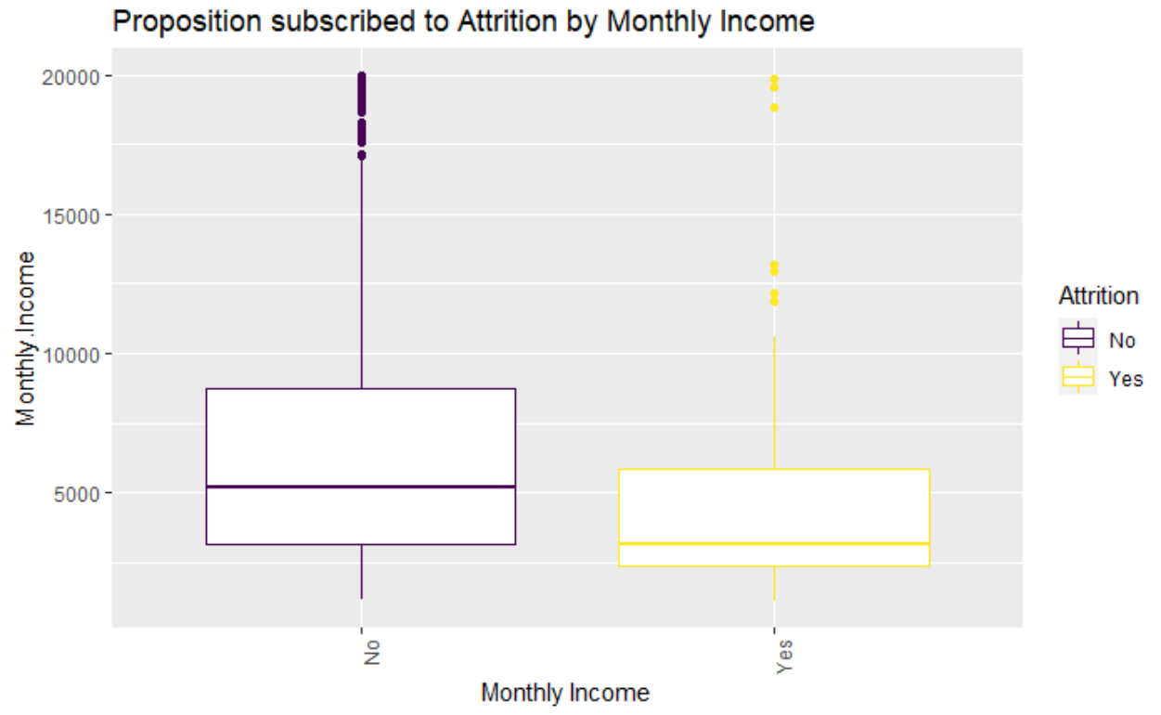
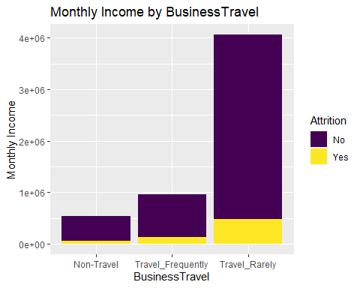
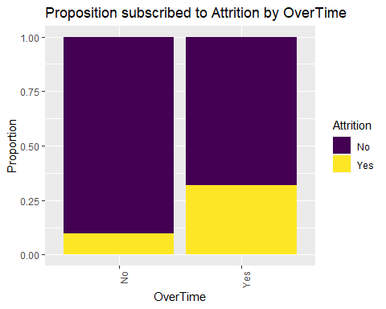
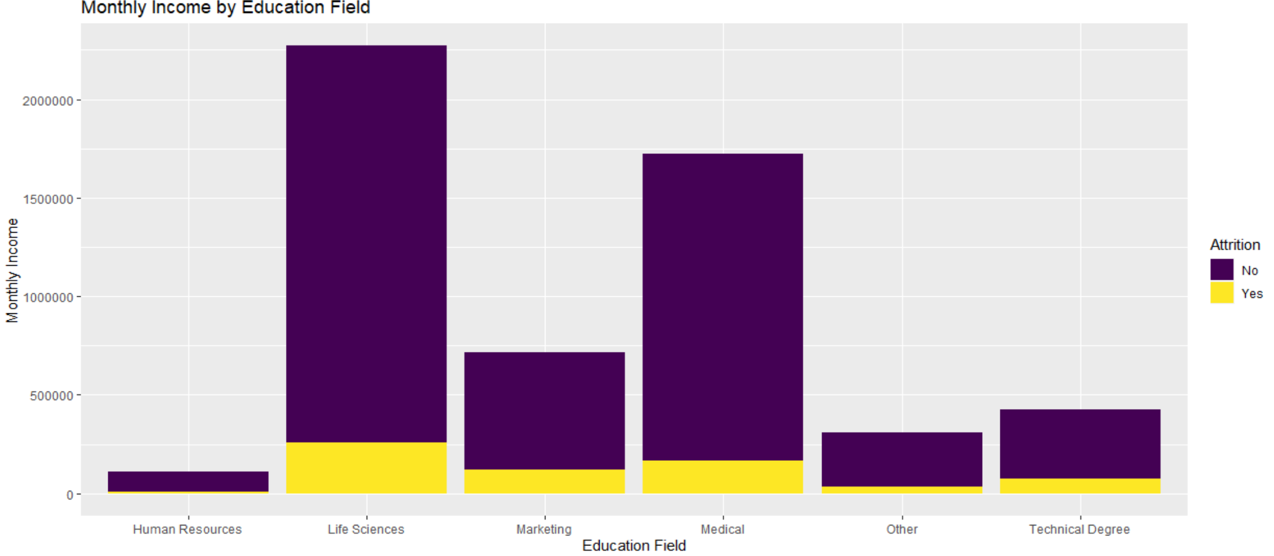
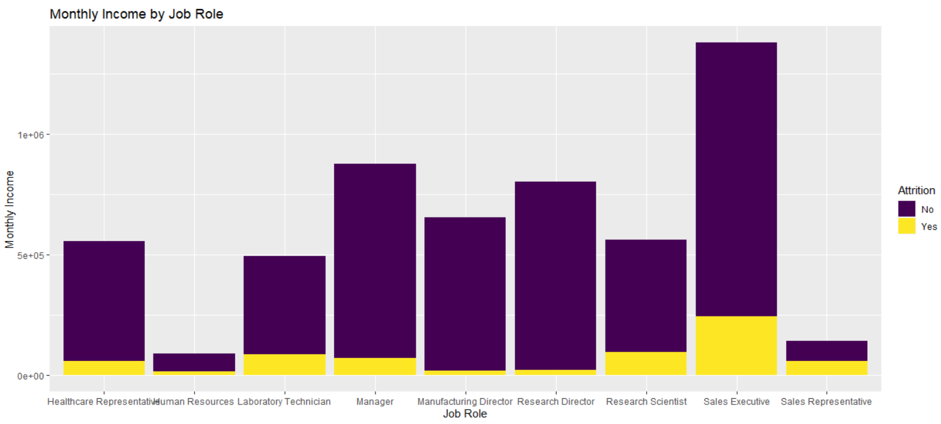
Factors Contributing to Attrition
Major Factors that contribute to Attrition are:
Lower Monthly Income
Frequent Business Travel Jobs
Overtime Work
Employees in Sales Department
Employees in Human Resource, Technical Degree and Marketing Educational Field
Job Role : Sales Rep and Human Resource followed by Laboratory Technician, Research Scientist and sales executive

Slide 10
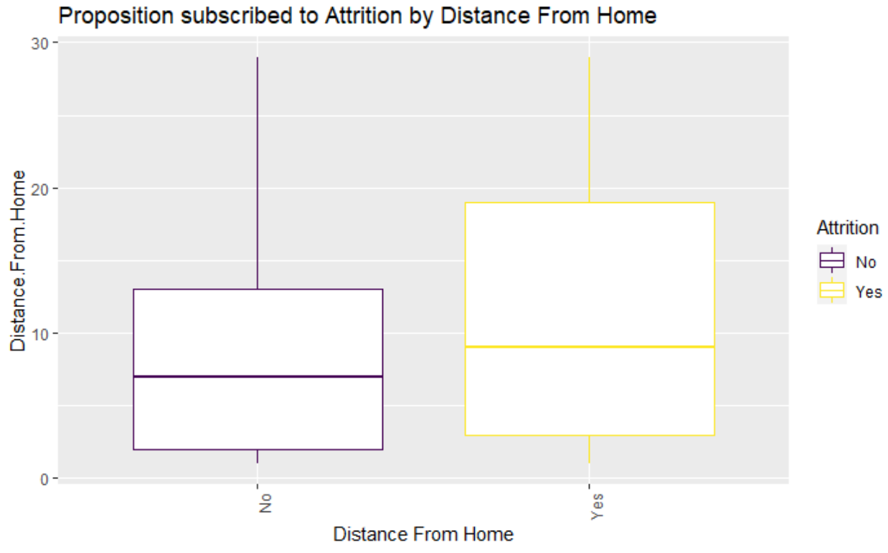
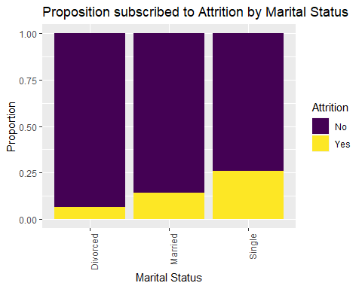
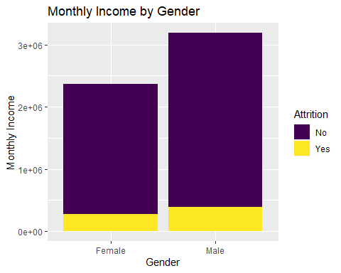
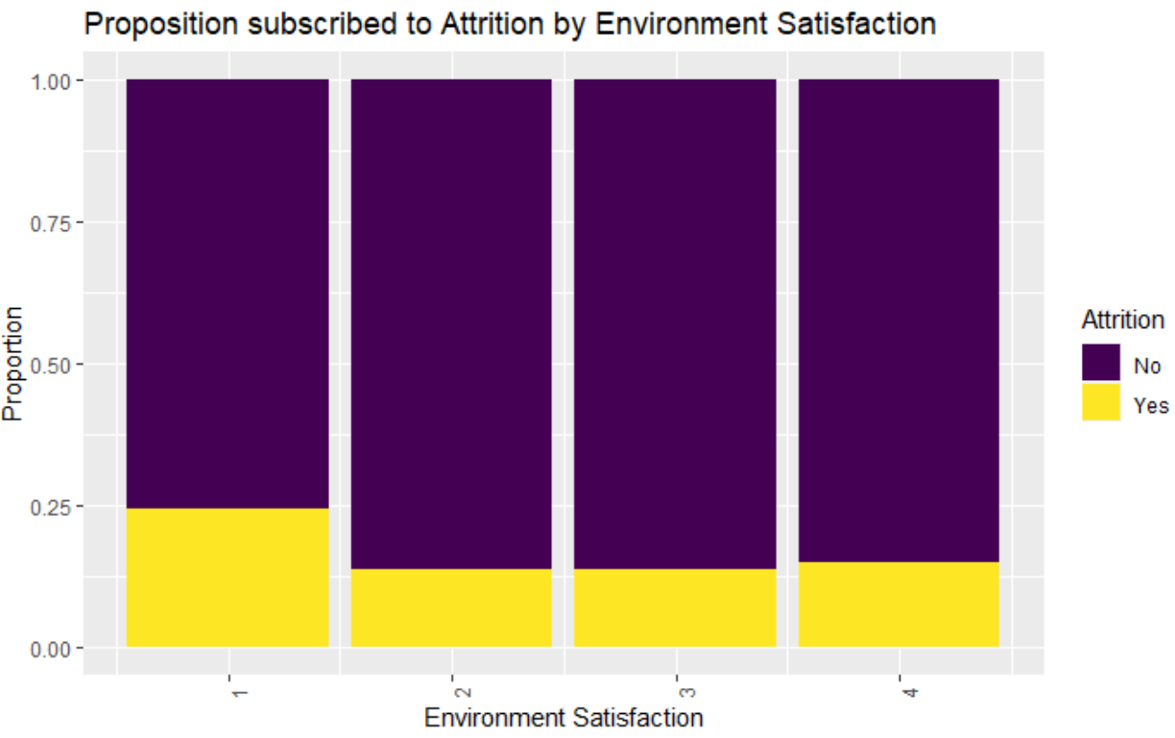
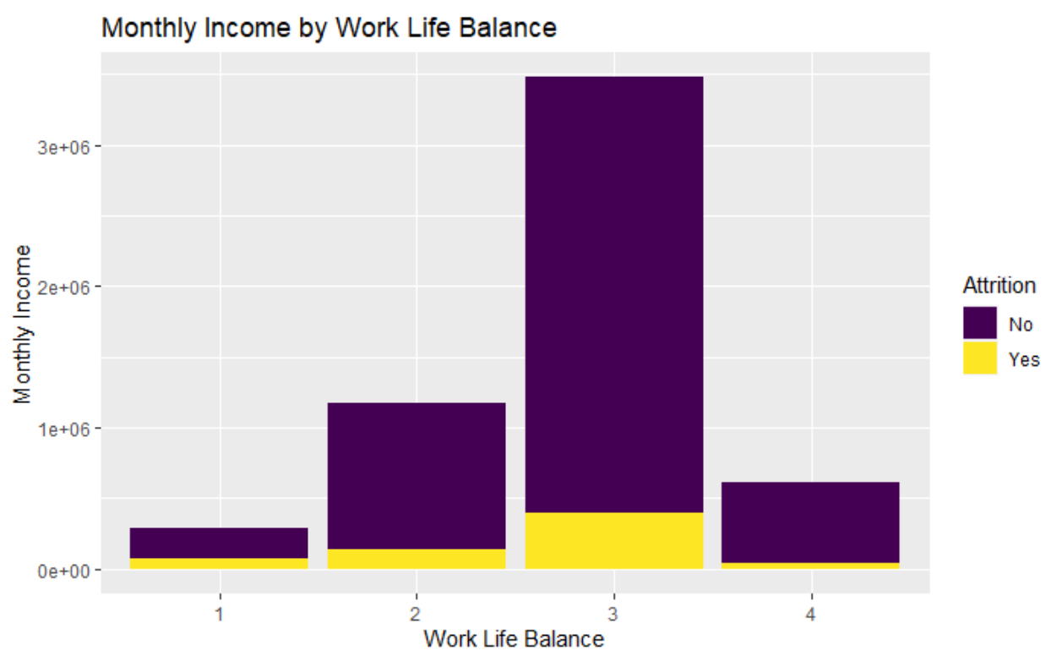
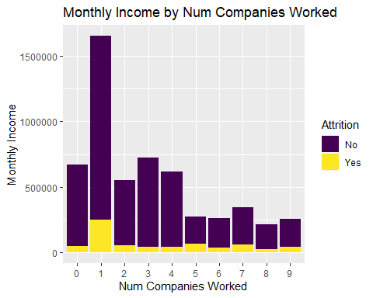
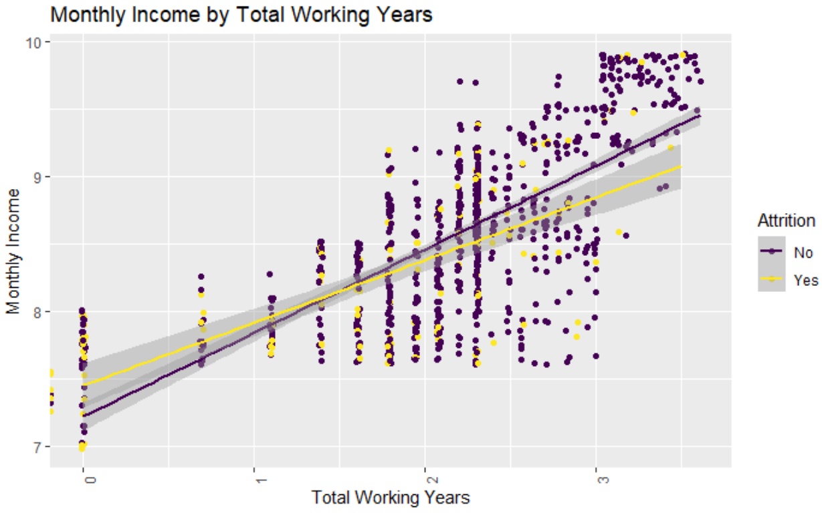
Factors Contributing to Attrition
Major Factors that contribute to Attrition are:
Longer Distance to Trave from home
Marital Status – Singles
Lower Environment Satisfaction
Male Employees are more prone
Lower working Years
No work life Balance
Higher Years in current Role

Slide 11
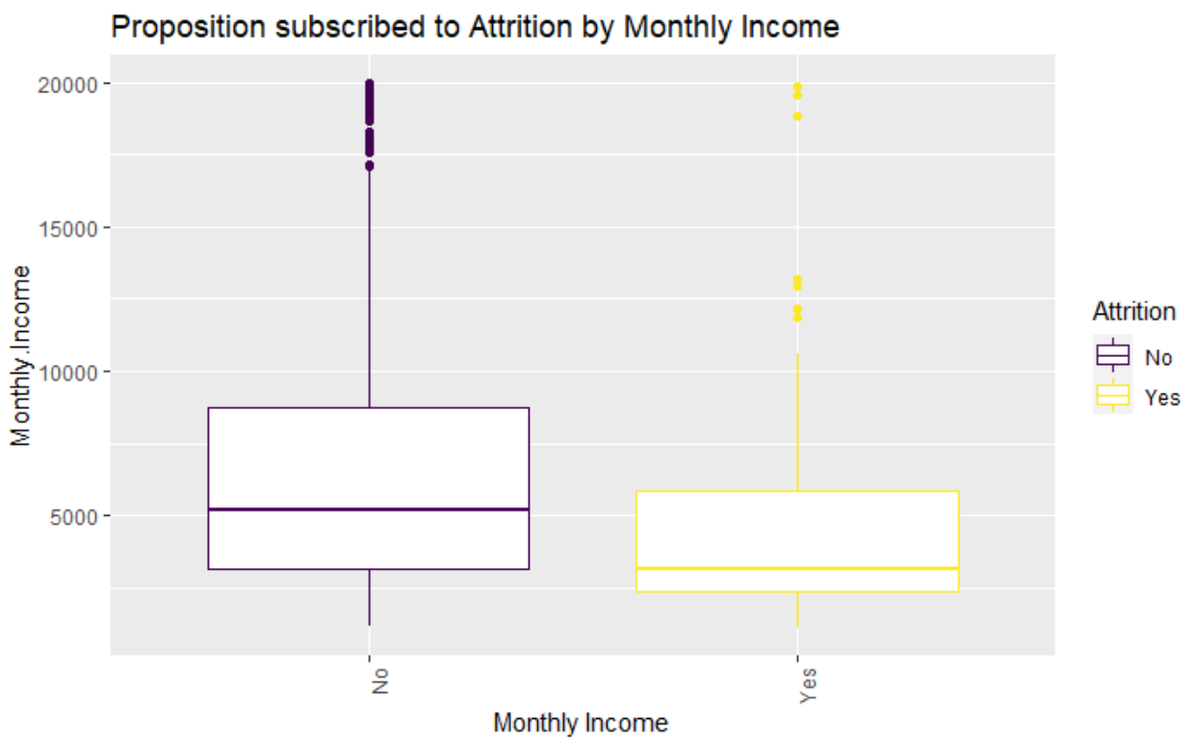
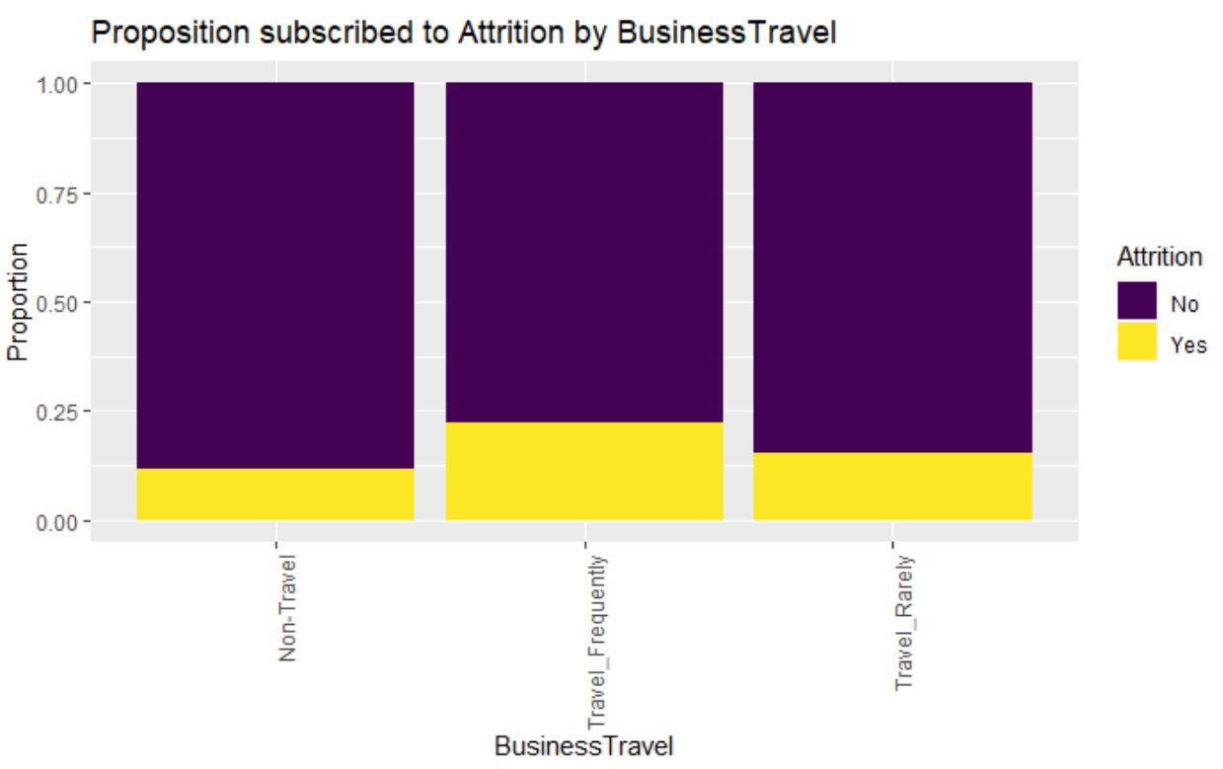
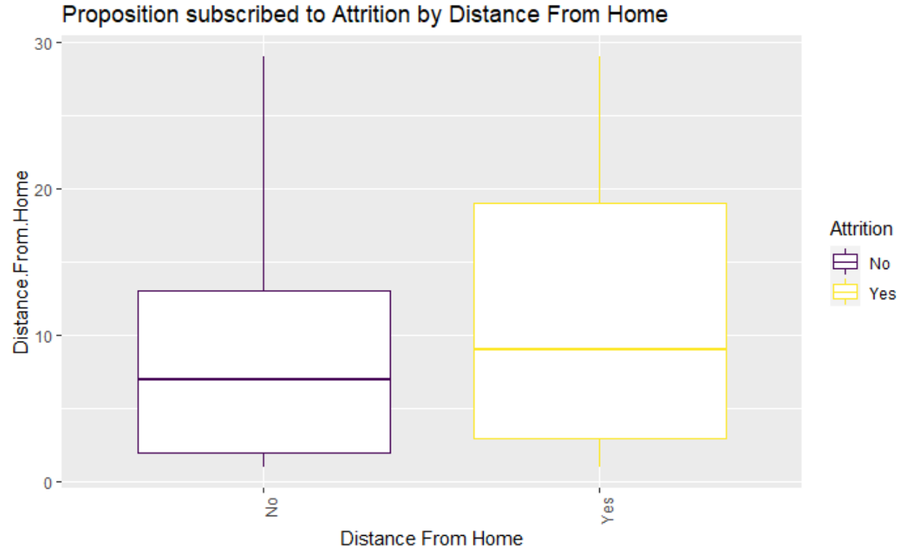
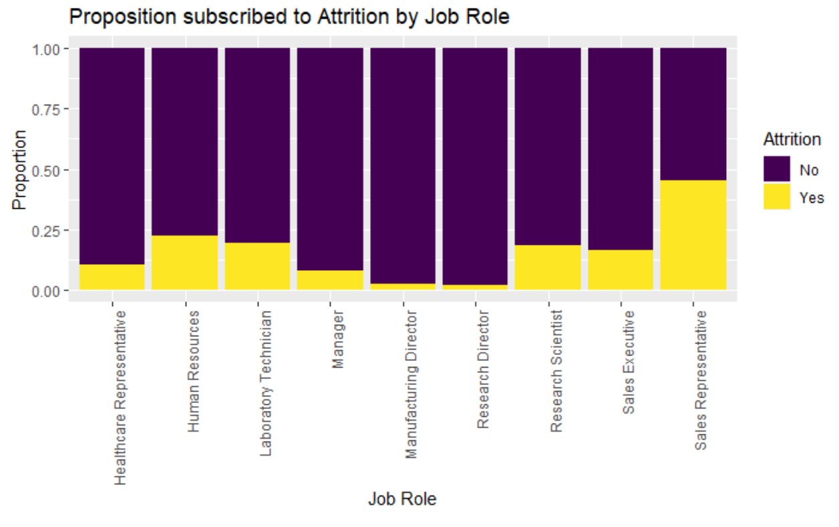
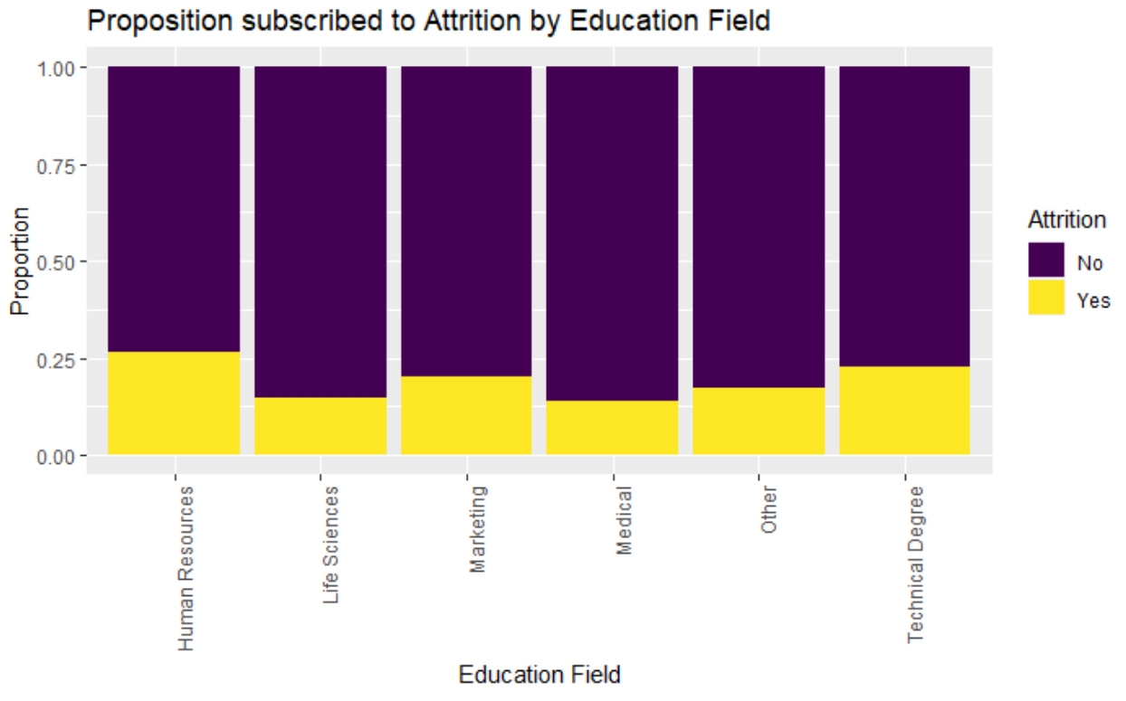
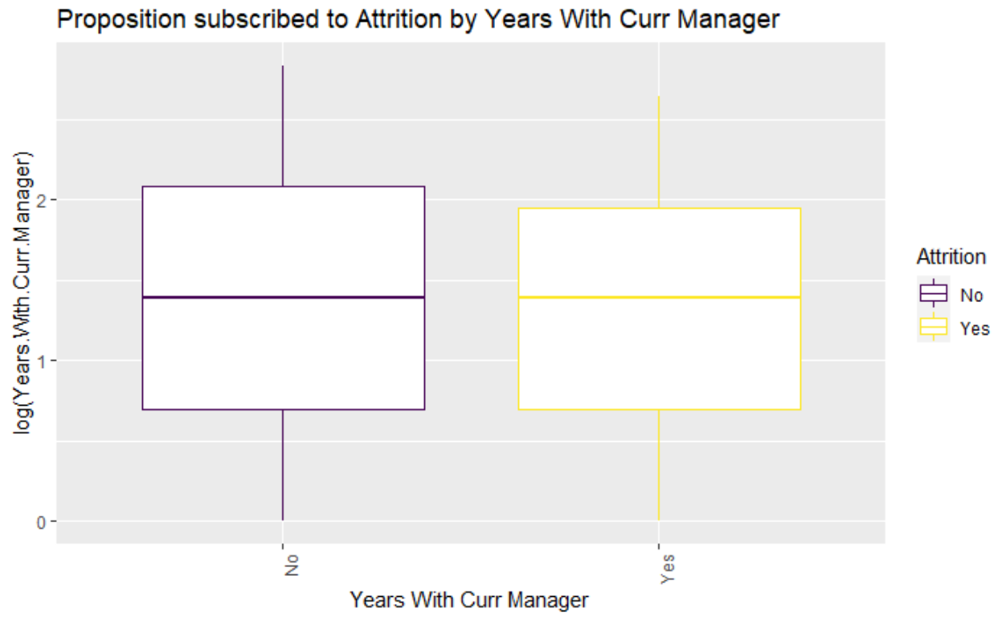
Content Employees
Major Factors that contribute to Content Employees are:
Higher Monthly Income
Non-Business Travel Jobs
Life science, Medical and Other Educational Field
Manufacturing Director & Research Director Job Role
Less distance to travel from home
Married & Divorced Employees
Female employees
Worked in lesser number of companies
Higher working years
Longer years with current manager

Slide 12
Data Analysis
Correlation

Slide 13
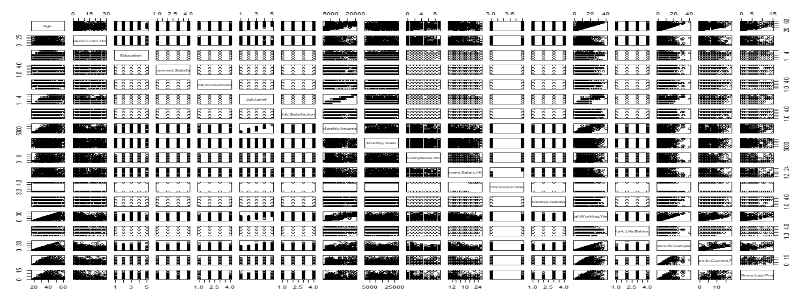
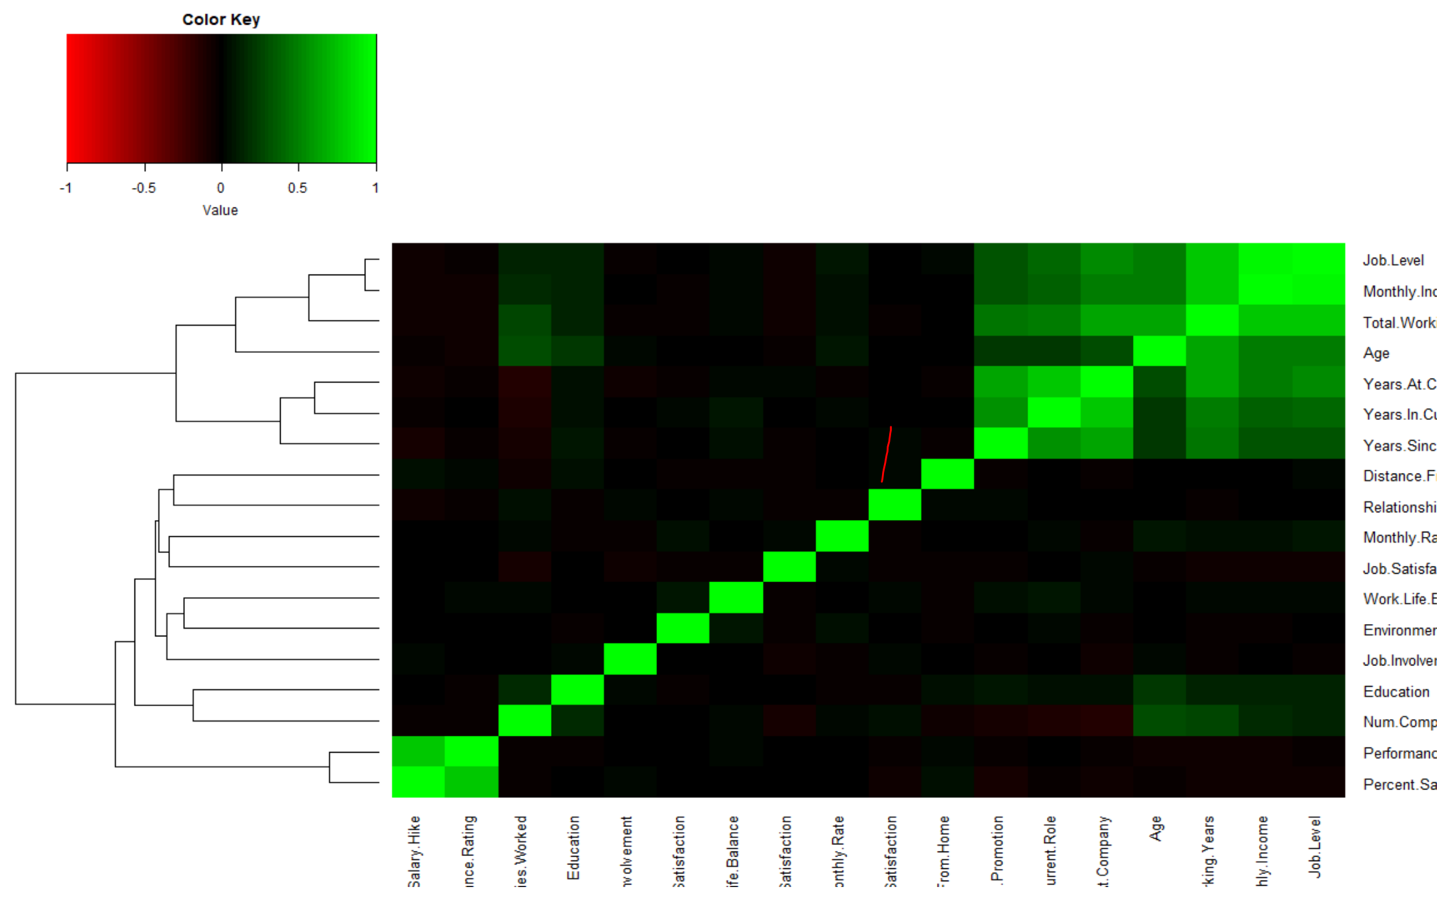
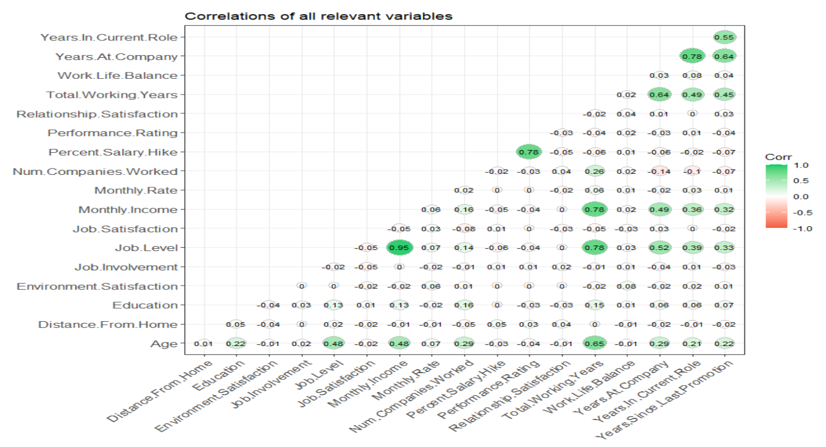
Correlation Summary
Job Level and Monthly Income are highly positively correlated (0.95)
Percent Salary Hike and Performance Rating are highly positively correlated (0.78)
Monthly Income and Total Years of working is highly positively correlated (0.78)
Job Level and Total Years of Working is highly positively correlated (0.78)
Years at company and Years in current role is highly positively correlated (0.78)
Age and Total Working Years is positively correlated (0.65)
Years at company and Years since last promotion is positively correlated (0.64)
Total working years and years at company is positively correlated (0.63)
Years in current role and Years since last promotion is positively correlated (0.55)
Job Level and years at company is positively correlated (0.52)

Slide 14
Model Analysis
Predict Monthly Income

Slide 15
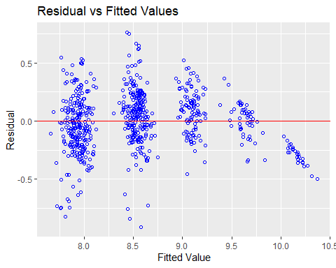
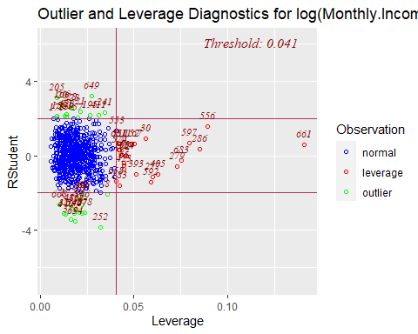
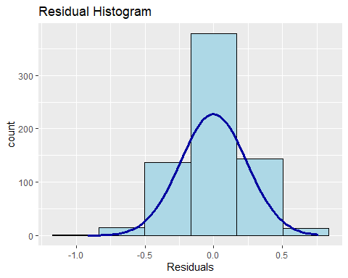
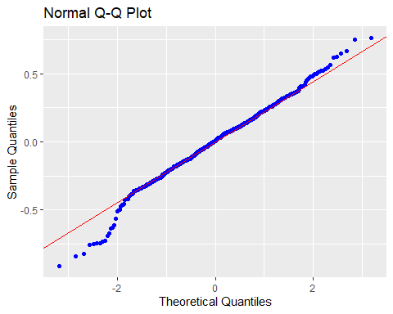
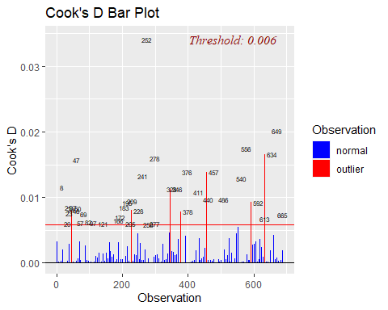
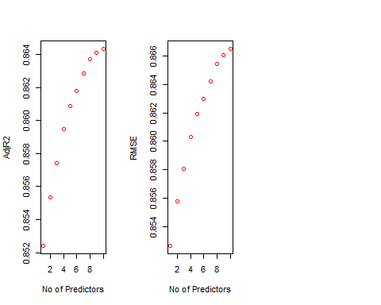
Predict Monthly Income
Our goal for objective one was to build an interpretable regression model that identified important relationships between predictors and the client's decision to predict Employee Monthly Income
We randomly split our data into an 80% training and 20% test set with 695:174
Analyzing the assumptions from the residuals
The histogram shows a bell shape curve which suggests that there is enough evidence for normality.
The QQ Plot shows a straight line which suggests that there is enough evidence for constant variance
The observations are independent as they are randomly selected from different departments
The outlier at 252 seems to be not a high leverage and leaving in the dataset for now.

Slide 16
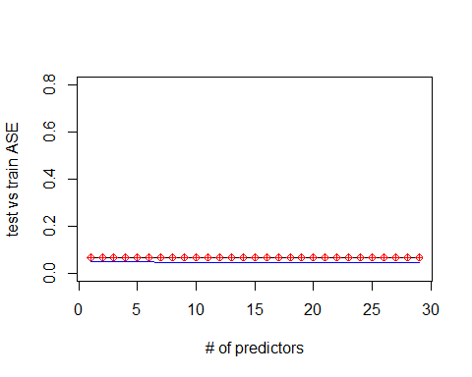
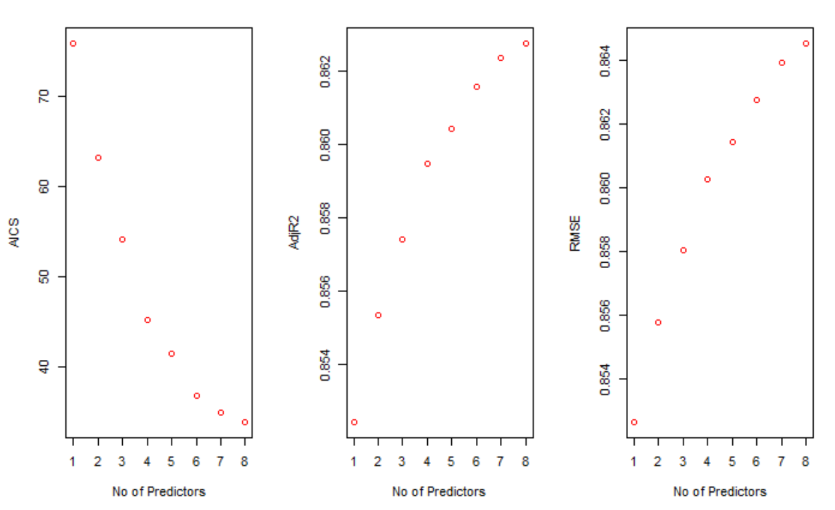
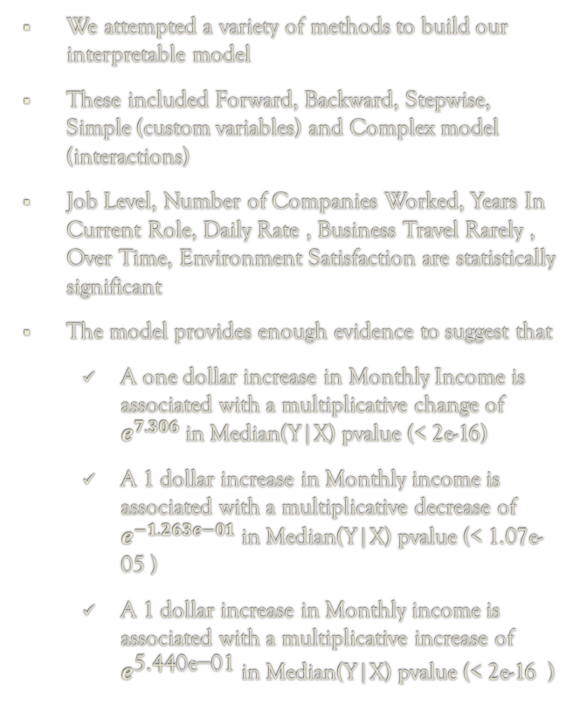
Predict Monthly Income
Model Selection | MSPE | Adj. R-Squared | RMSE | R-Squared | AIC
Forward (simple) | 0.06735389 | 0.864 | 0.244 | 0.866 | 27.96347
Backward (simple) | 0.06832213 | 0.865 | 0.244 | 0.867 | 27.43173
Stepwise (simple) | 0.06832213 | 0.866 | 0.244 | 0.866 | 27.96347
Simple (Custom) | 0.06924576 | 0.863 | 0.246 | 0.865 | 33.84238
Complex (Interactions) | 0.06924576 | 0.863 | 0.246 | 0.865 | 33.84238
We attempted a variety of methods to build our interpretable model
These included Forward, Backward, Stepwise, Simple (custom variables) and Complex model (interactions)
Job Level, Number of Companies Worked, Years In Current Role, Daily Rate , Business Travel Rarely , Over Time, Environment Satisfaction are statistically significant
The model provides enough evidence to suggest that
A one dollar increase in Monthly Income is associated with a multiplicative change of $e^{7.306}$ in Median(Y|X) pvalue (< 2e-16)
A 1 dollar increase in Monthly income is associated with a multiplicative decrease of $e^{−1.263e−01}$ in Median(Y|X) pvalue (< 1.07e-05 )
A 1 dollar increase in Monthly income is associated with a multiplicative increase of $e^{\text{5.440}\text{e}\text{−01}}$ in Median(Y|X) pvalue (< 2e-16 )

Slide 17
Model Analysis
Predict Attrition

Slide 18
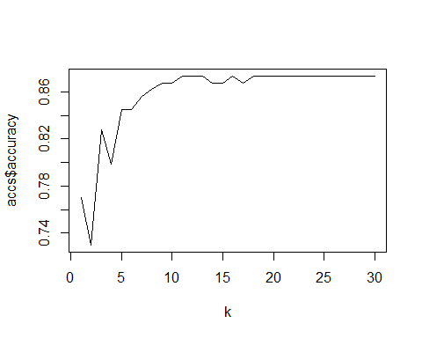
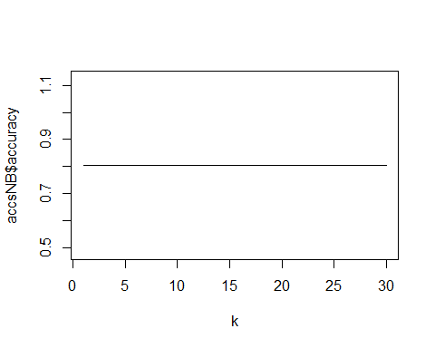
K Nearest Neighbors (k-NN) & Naïve Bayes (NB)
Model Selection | Accuracy | K Value | Sensitivity | Specificity | 'Positive' Class
KNN | 0.8678 | 15.5 | 0.98684 | 0.04545 | No
NB | 0.7529 | 15.5 | 0.8286 | 0.4412 | No
The K-NN & Naïve based classification is used to predict the attrition status of the employee with improved accuracy
Our strategy is to find the closest applicants and let the majority rule to predict the Attrition Status would be Yes or No for an Employee with similar backgrounds
The prediction result for KNN is
No Yes
No 150 21
Yes 2 1
The prediction result for NB is
No 116 19
Yes 24 15
The average accuracy is 0.8833 and k=15.5 in KNN and average accuracy is . 0.8045977 and k=15.5 for NB
KNN Classification
NB Classification

Slide 19
Conclusion

Slide 20

Conclusion
Employee attrition and absconding are significant business concerns in today’s knowledge- driven marketplace, where employees are the most assets
The Society predicted that the greatest test of durability for companies in the next five years would be the ability to attract and retain top performers
Attrition Types:
Fresher Attrition & Infant Morality : (Freshers & Employees leaving < 1 year
Critical Resource Attrition : Attrition of key personnel
Low performance Attrition: Poorly performing employees' attrition
Attrition has the below impacts on the Company:
Performance decrease due to insufficient employees
Causing existing employees to work harder resulting in work life imbalance
Cost of replacing staff is high
Failure in company ability to set effective HR policy

Slide 21
Inference
Recommendations

Slide 22

Inference & Recommendations
Employees are an integral part of a company s success, and we need to ensure we retain some of the high performing employees for the growth of the Company
Esteem ,Acknowledgement, Higher Position and Income would mean status respect for any Employee
Internal Motivations, Career Development , Continuous Learning Challenges, Work Life Balance are some of the key motivators of any professional
These internal motivators become crucial elements of the retention policy

Slide 23


Slide 24
Questions

Slide 25
Thank You!

Slide 26
Appendix

Slide 27
Data Analysis
Attrition

Slide 28
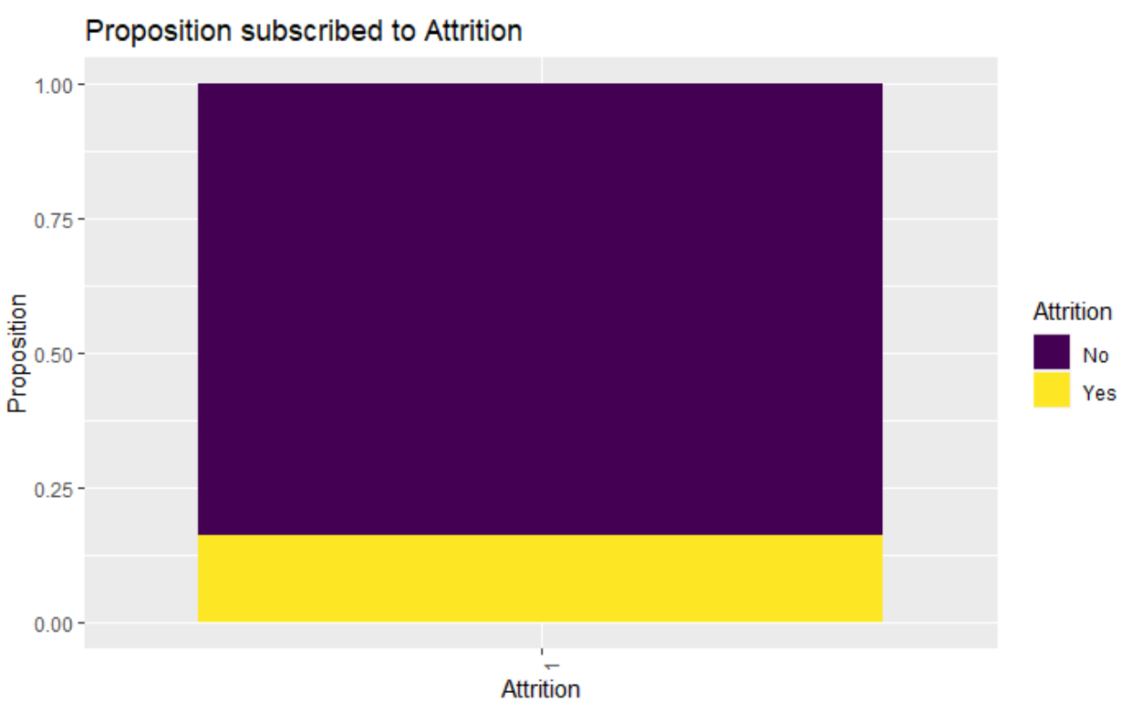

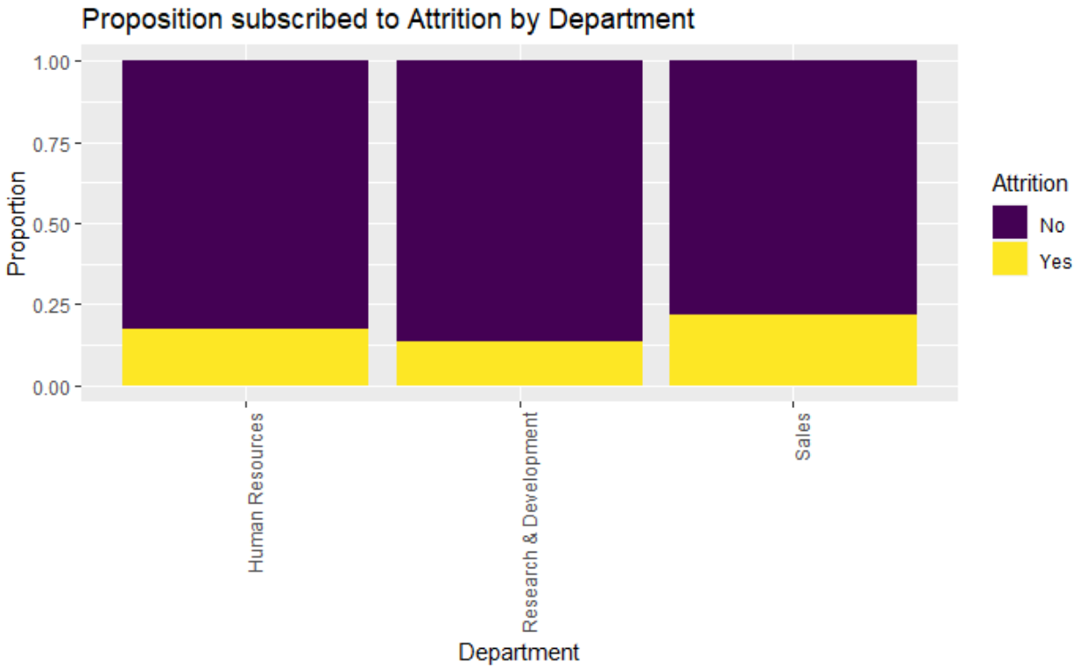
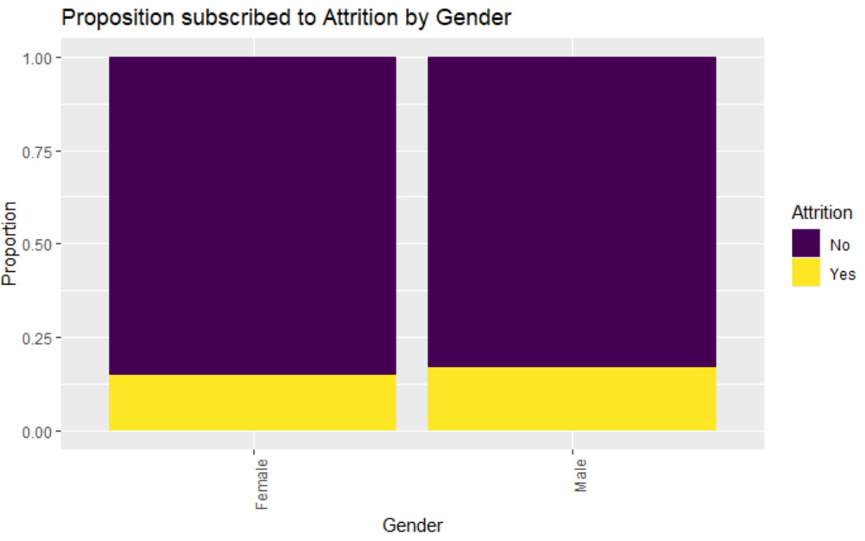
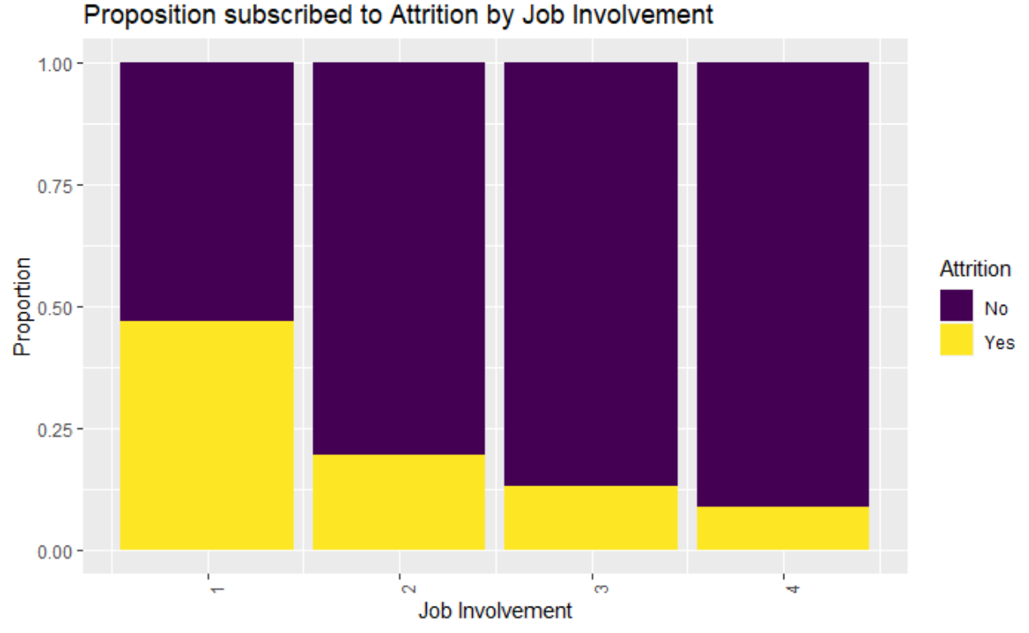
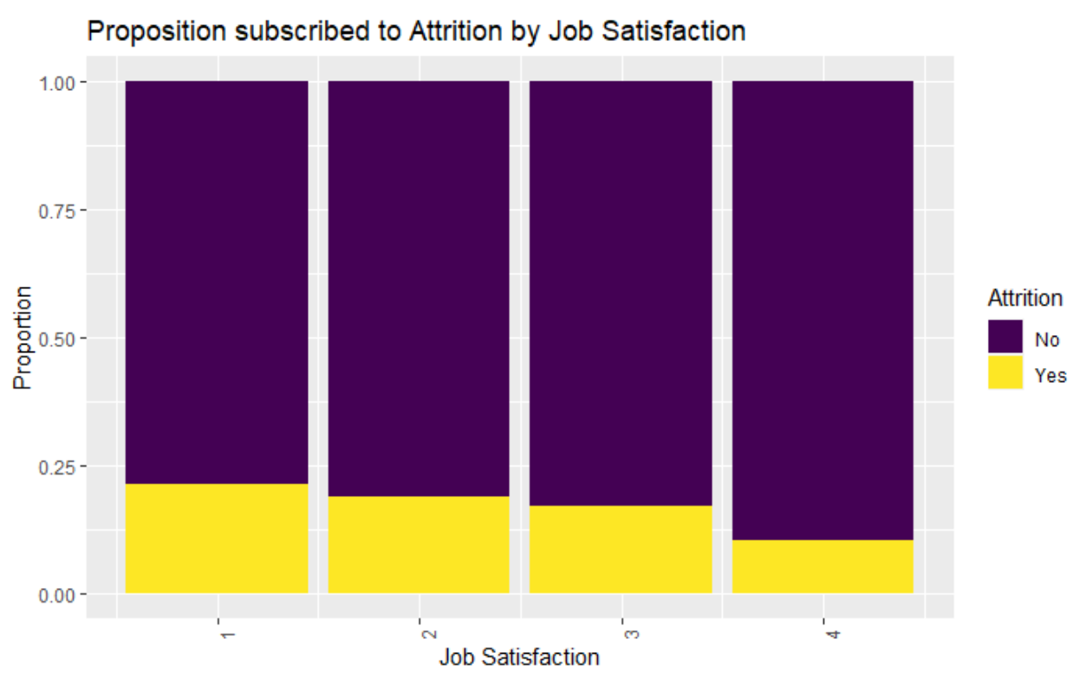
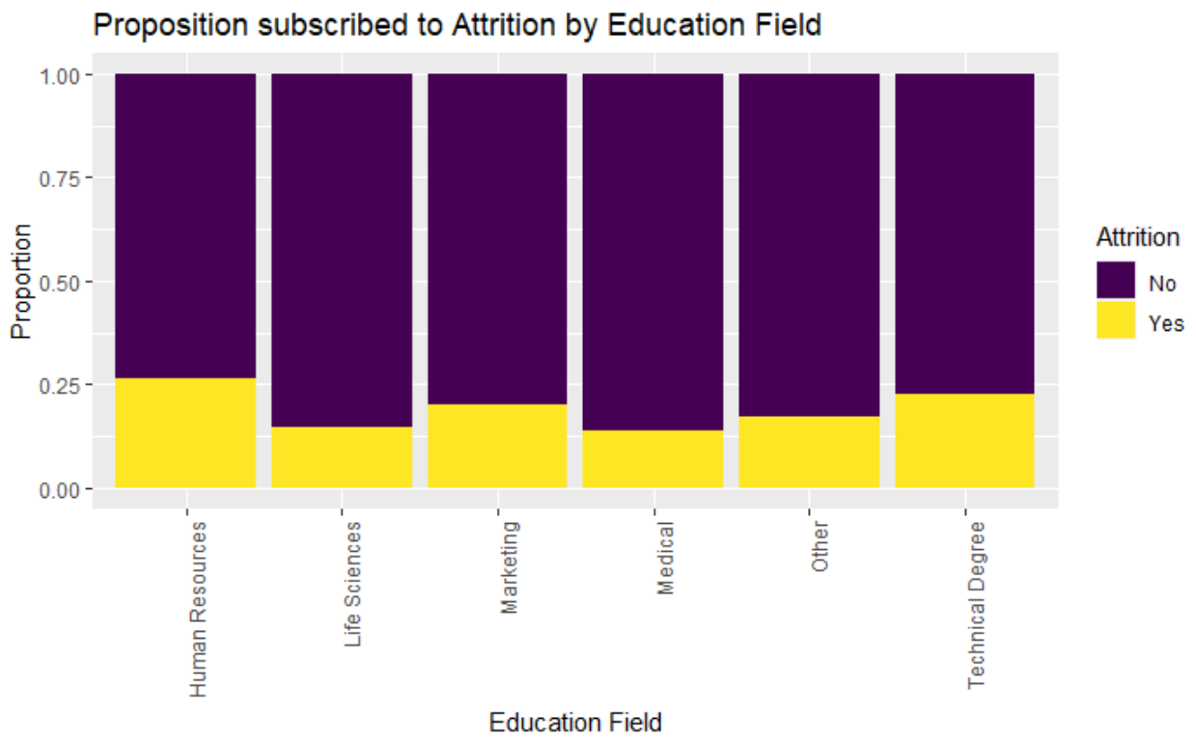

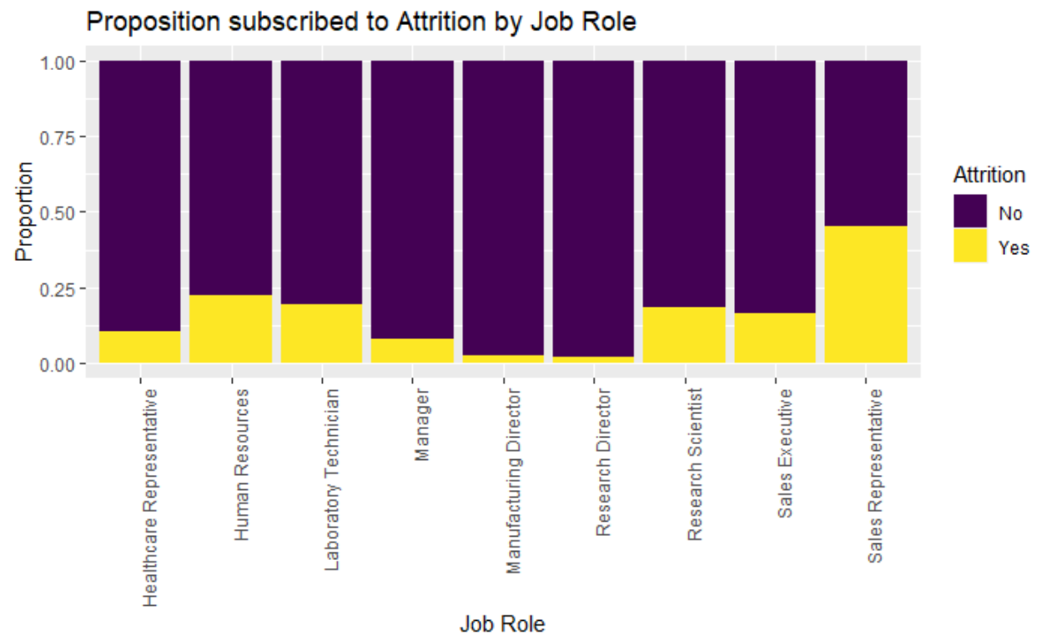
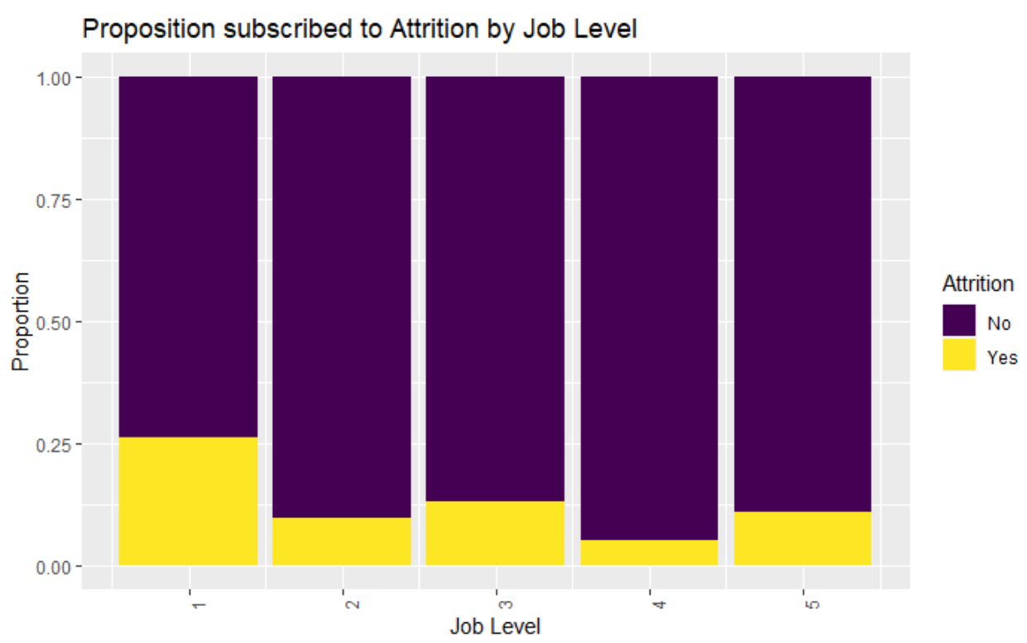
Employee Attrition Summary
Overall attrition rate : 16%
Attrition Rate : Higher for Age < 35 and Age >50
Frequent Travel Jobs see more Attrition
Sales Department has most attrition and Research&Development department has the least
Environment Satisfaction & Job Involvement, Job Level and Job satisfaction seems more attrition in level 1 than 2,3 and 4
Attrition rate is slightly more with Males than Female employees
Attrition Rate is more at Education level 1,2 and 3 than 4 and 5
Human Resource, Technical Degree and Marketing see more attrition than Life science, Medical and Other
Attrition Rate seems to be more for Sales Rep and Human Resource. Laboratory Technician, Research Scientist and sales executive are the next in row for attrition. Manufacturing Director & Research Director are more content with their job

Slide 29
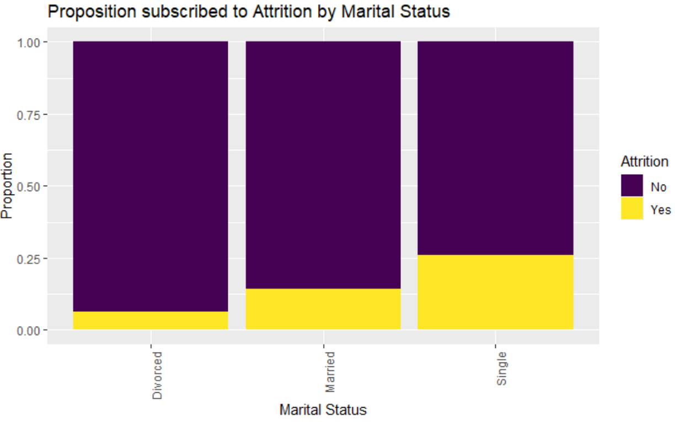






Employee Attrition Summary
Attrition Rate seems to be more with Singles
Employees who have worked in more than 4 companies are more prone for attrition
Attrition is more for Employees who work overtime
Employees with performance rating 3 and 4 or who have a work life balance rating of 1 is more prone to attrition
Attrition is more for employees who have relationship satisfaction 1
Employees who have stock option 0 and 3 are more prone to attrition

Slide 30





Employee Attrition Summary
The Attrition rate is more for Employees with lesser daily rates
Employees who travel longer are prone to attrition
Attrition is more for employees with lower monthly income and higher monthly rate
Not much difference is seen with percent salary hike on attrition

Slide 31





Employee Attrition Summary
Attrition rate is more with employees with lower total working years
The employees who worked for longer years in a company are more content and satisfied
Attrition Rate seems to be more for Employees who were in the current role for less years
Attrition Rate seems to be more for Employees who were not promoted to next level for quite some time
Employees with the same manager for longer were more content than those who changed manager or were with different managers

Slide 32
Data Analysis
Monthly Income

Slide 33

Employee Monthly Income Summary
Attrition is higher for Employees earning lower monthly income

Slide 34











Employee Monthly Income Summary
Monthly Income data is slightly skewed
Monthly Income is linearly correlated to Age. As age increases the monthly income of the Employee increases
Employees who travel rarely seem to have higher monthly income but attrition is more for frequently travel jobs
Employees in Research & Development and Sales earn more than those in Human Resource. Maybe this is the reason for attrition to be high in Sales
Monthly Income is the highest for Life sciences & Medical and least for Human resource
Employees with Education Level 3 earns higher income and attrition is higher for level 1,2 and 3
Employees who work overtime have higher monthly income and attrition is more on this side
Employees with environment satisfaction 3 & 4 earn higher monthly income than 1 & 2 where attrition is more maybe because of the lower monthly income
Male have a higher monthly income than Female employees and maybe the demand is more and hence the attrition rate higher among male than female employees
Job Involvement, Job Level and Job satisfaction seems more attrition in level 1 as they earn lower monthly income comparatively

Slide 35











Monthly Income Summary
Monthly income is higher for married employees and attrition rate is higher for singles
Monthly income is higher for employees who have worked in 1,3,4 companies and maybe that is why attrition is higher for employees who have worked in more than 4 companies
Monthly income and total working years is linearly correlated
Employees with relationship satisfaction 3, 4 earn higher and hence attrition rate is higher for employees with relationship status 1
Employees with stock option level 0 and 1 earn higher and hence attrition rate is higher in this case and for 3 as they are low paid
Years at company and total working years are linearly correlated to monthly income

